Slide 1

Customer Review Analysis

Slide 2
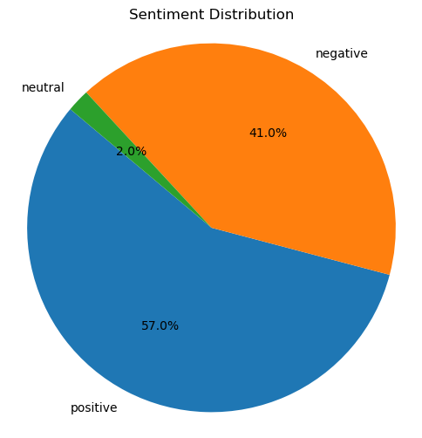
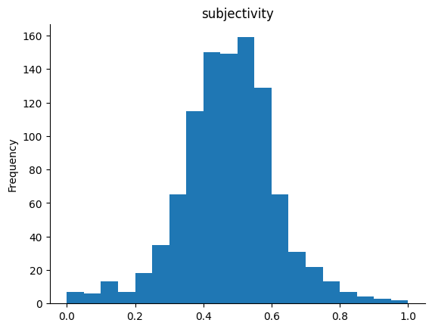
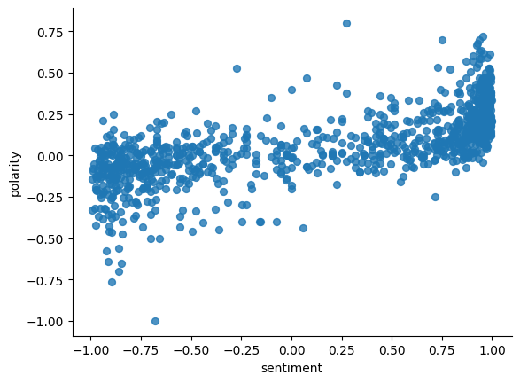
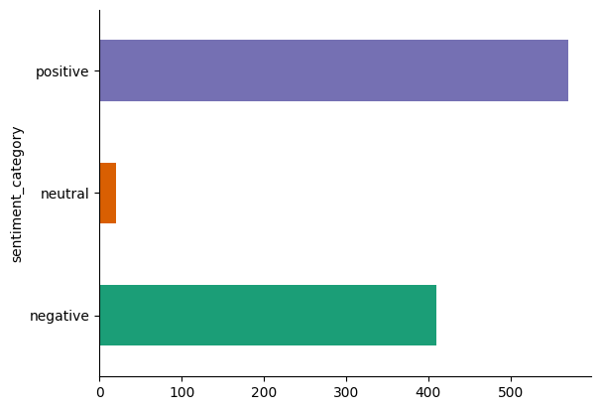
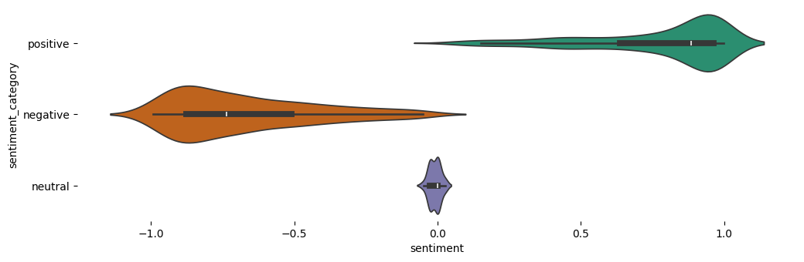
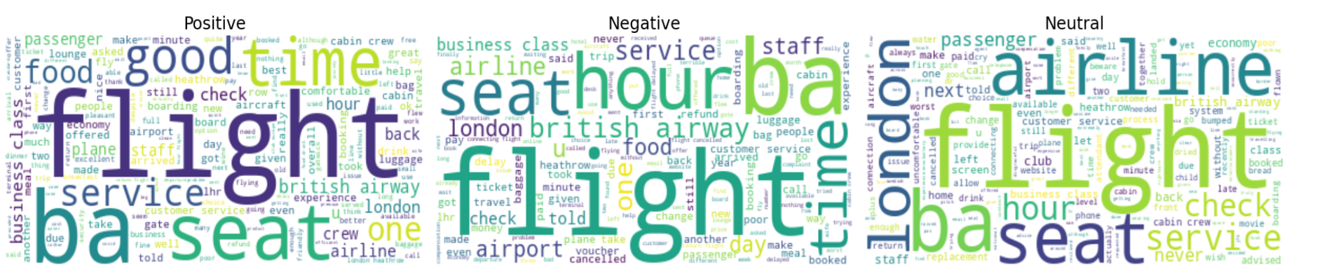
Conclusion
Dominant Sentiment: Positive
Word Cloud suggests common themes like "good time," “food," "customer service,“
The Bar graph depicts general perception and line graphs suggest increasing positive sentiment or decreasing negative sentiment.

